Slide 1
Programming for Image Processing/Analysis and Visualization using
The Visualization Toolkit
Week 2: An Introduction to Tcl
http://noodle.med.yale.edu/seminar/seminar.html
Man Pages etc: http://noodle.med.yale.edu/tcl
(See also lectures on Programming Using Tcl/Tk
by Dr. Ernest J. Friedman-Hill
http://herzberg.ca.sandia.gov/TclCourse/)
Xenios Papademetris
papad@noodle.med.yale.edu
BML 325, 5-7294

Slide 2
Schedule – Part 1
Introduce VTK (today)
Introduce Tcl/Tk
Simple Visualization Tasks
Simple Image/Surface Manipulation
More on Images and Volume Rendering
Local Extensions
  (Marcel: Itcl/Itk/Iwidgets, more advanced GUI generation etc.)

Slide 3
Schedule – Part 2
C++ Fundamentals, Pointers/Classes
Object Oriented Programming
Adding new VTK Commands/Cmake
More on Images and Surfaces
Case Study I – Computing t-maps in fMRI
Case Study II -- Iterative Closest Point surface matching
Case Study III – Linear Mutual Information Multimodal Registration

Slide 4
Scripting Language Philosophy
1
Program size, complexity, reuse
0
Large, complex applications:
  Performance important.
  Need structure.
  Goal: prevent bad things.
Interactive commands, scripting:
  Performance less important.
  Minimum structure: less overhead, easy interchange.
  Goal: enable good things.
Can one language meet all needs?

Slide 5
Two Language Approach
1
Program size, complexity, reuse
0
C
Tcl
Use Tcl for scripting, C or C++ for large things.
Goals for Tcl:
1. Minimal syntax: easy to learn and type.
2. Minimal structure: make things play together.
3. Simple interfaces to C/C++: extensibility.
This is the Key Feature for us!

Slide 6
Multi-Platform Program Structure
Our own Tcl/Tk Code (or Python, Java)
Our own C++ Code
Tcl / Tk
(or Python/Tk
or Java)
VTK
Open GL
Computational
Aspects
3D
Graphics
Graphical User
Interface (GUI)
Hardware Layer (Windows/Linux/Unix/Mac OS X)

Slide 7
Intepreters
Tclsh (tclsh8.3) – no graphical user interfaces, base tcl language only.
Wish (wish8.3) – tcl and graphical user interface stuff (tk)
Vtk (vtk) – wish and vtk extensions
Pxvtk (pxvtk) – vtk and local extensions written here at Yale
On SGI/Linux before starting type:
source /usr/local/vtk4/setvtk
To set the proper paths, tested on cortex/retina/pelvis/edema/ventricle/fimbria/suture/derwent
and machines in MRI group

Slide 8
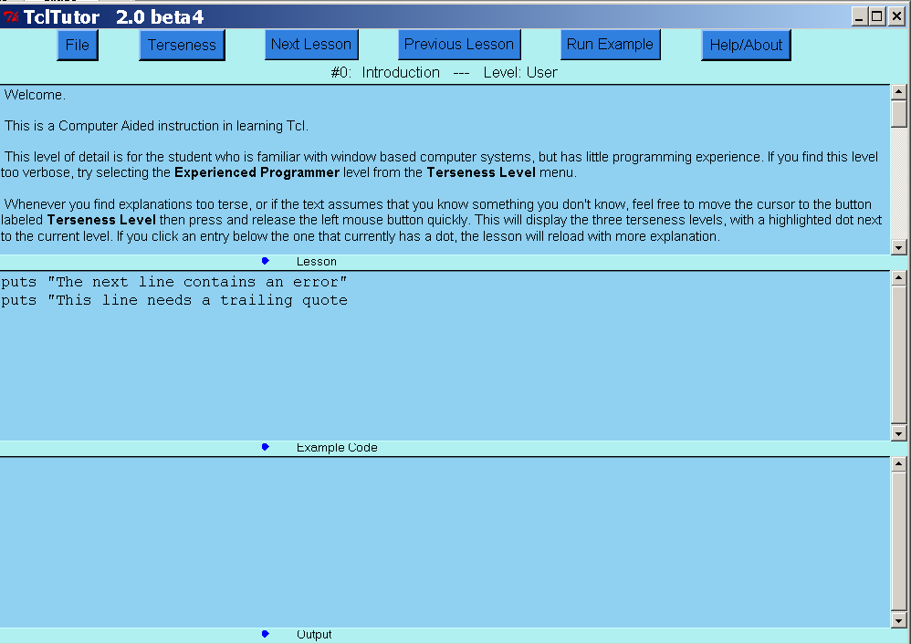
Key Tool: TclTutor

Slide 9
Tcl By Example
Variables (Essentially Strings)
% set foo 10
10
% set bar "Hello"
Hello
% puts stderr "$foo $bar"
10 Hello
% set temp hello$foo
hello10
% set temp foo
foo

Slide 10
Tcl By Example
Flow control
for { set i 0 } { $i < 10 } { incr i 1 } {
puts stdout $i
}
set i 0
while { $i < 10 } {
puts stdout “i=$i”
incr i 2
}
if { $i < 10 } {
set j 0
} else {
incr i
}

Slide 11
Tcl By Example
Procedures
set var 10
proc procedure { a } {
global var
puts stderr "Entering procedure"
set val [expr $a * $var]
return $val
}
set val [procedure 3]
[ ] is the operator for returning the result of something
i.e. [ procedure 3 ] is the output of calling procedure with an argument of 3

Slide 12
Math Operations
All math operations need expr command
This is not valid as by default everything is a string!
% set i 2+2
2+2
% set i [ expr 2+2 ]
4
expr parses the operation numerically i.e. not as a string!

Slide 13
Lists
Complex Variable Structure
Lists are everywhere in Tcl!
Create a list
% set l [ list 1 2 3]
1 2 3
Get an Element of the List (First Element has index 0)
% set a [ lindex $l 1 ]
2
Get the Length of the List
% set a [ llength $l ]
3
Other Commands lappend,lsort,linsert etc

Slide 14
Strings
Every variable is implictly a string
Strings can be manipulated using the string command
% set l [ string length ”Hello”]
5
% string range "Hello" 2 4
llo
% string index "Hello" 1
e
Lots of other options ….

Slide 15
Associative Arrays
Another Complex Variable Structure
Create an array (implicitly)
% set a(1) ”Hello”
% set a(2) ”Help”
% puts stdout ”$a(1), $a(2)”
Hello, Help
Modify array using array command

Slide 16
Calling Other Programs
The exec command can be used to call other programs i.e.
exec emacs
or
exec notepad
or
set f1 “inputimage.hdr”
set f2 “outputimage.hdr”
puts stdout “Executing myprogram to filter $f1 to $f2”
exec myprogram $f1 $f2
puts stdout “myprogram done!”
… code to display $f2

Slide 17
Text File I/O
Standard Unix Files stderr/stdout
New Files using open command
set fileid [open "/winnt/temp/testfile" w]
puts $fielid “This is the first line”
puts $fielid “This is the second line”
close $fileid
Or
set fileid [open "/winnt/temp/testfile" r]
gets $fielid $firstline
gets $fileid $secondline
puts $stdout “Read\n $firstline \n $secondline”
close $fileid

Slide 18
File/Filename Manipulation
The file command
set fname “/home/papad/vtkpxcontrib/CMakeLists.txt”
set a [ file extension $fname ]
.txt
% set a [ file rootname $fname ]
/home/papad/vtkpxcontrib/CMakeLists
% set a [ file tail $fname ]
CMakeLists.txt
% set a [ file dirname $fname ]
/home/papad/vtkpxcontrib
% set a [ file size $fname ]
1024
Options for copying, deleting, moving files/directories etc

Slide 19
User Interfaces Using Tk
The problem:
  Too hard to build applications with nice user interfaces.
  Even harder to do so cross-platform
The wrong solution:
  C++, object-oriented toolkits, Java’s AWT
  Only small improvement (10-20%?): must still
  program at a low level.
The right solution:
  Raise the level of programming.
  Create interfaces by writing Tcl scripts.

Slide 20
User Interfaces Using Tk II
Additional Tcl commands:
  Create Motif-like widgets (on all platforms)
  Arrange widgets.
  Bind events to Tcl commands.
  Manipulate selection, focus, window manager, etc.
There exist bindings to Tk from other languages such as Python and Perl, Tcl is however the native language of Tk

Slide 21

User Interfaces Using Tk II
Create user interfaces by writing Tcl scripts.
Hello, world:
button .hello -text "Hello, world" -command exit
pack .hello
Simple directory browser: 30 lines
Web browser: 2000 lines
10x less code for simple things.

Slide 22
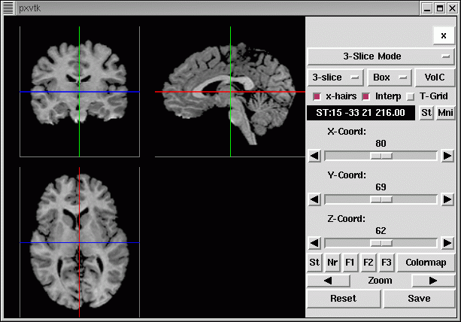
A Complex Example
Load and Display a 3D Image (pxvtk)
vtkpxAnalyzeImageSource ana
ana Load brn_1031.hdr
vtkpxGUIOrthogonalViewer ortho
ortho Initialize . 1
ortho SetImage [ ana GetOutput ] [ ana GetOrientation]

